Slide 1

O
Team
‘
’
La La Llama
Liaga Maria 2558
Pantazi-Kypraiou Maria 2596
Poulianou Chaido 2613
Chatzimichail Antonios-Kyrillos 2657

Slide 2
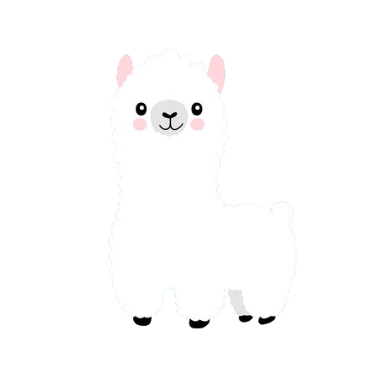
Main Idea
Collect the more apples you can by remaining in the rhythm of music and recreating the beat.
Avoid the rotten ones.
Achieve the biggest highscore.

Slide 3
Genre
Rhythm game
Music game
Action
Educational
Interactive
Reflex game

Slide 4
Game World
•The game world changes in each level.
•The game character travels through different and various world-environments collecting apples.
•Each level has a different song, with the apples coming to the llama in the beat and rhythm of the.
•Rotten apples appear as well, in order to challenge the player. If 3 rotten apples are hit… game over! Restart level or go back to the main menu.
•Collecting apples increases your overall score and unlocks stars, which are needed to unlock and play the next levels.

Slide 5
Features
Every player has the chance to:
Have a good and amazing use of his time
Learn about different genres of music by listening and playing to the rhythm of the various songs.
Strengthen their perception on rhythm and synchronization.
Relieve their stress or even challenge themselves.

Slide 6
Marketing Strategy
Facebook & Instagram ads
Google ads
Youtube ads (Gameplay promotion)
Video Games websites
La La Llama logo

Slide 7
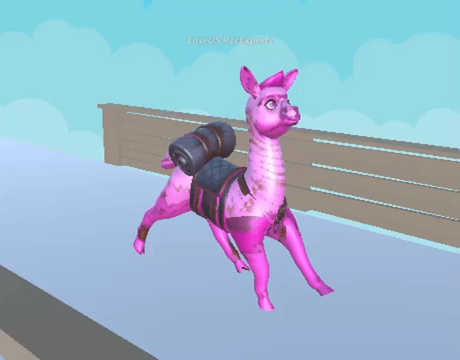
Characters
Identity
Name: Llama Del Ray
Age: 8 months
Dream: Bring back all the apples and make her family proud!

Slide 8
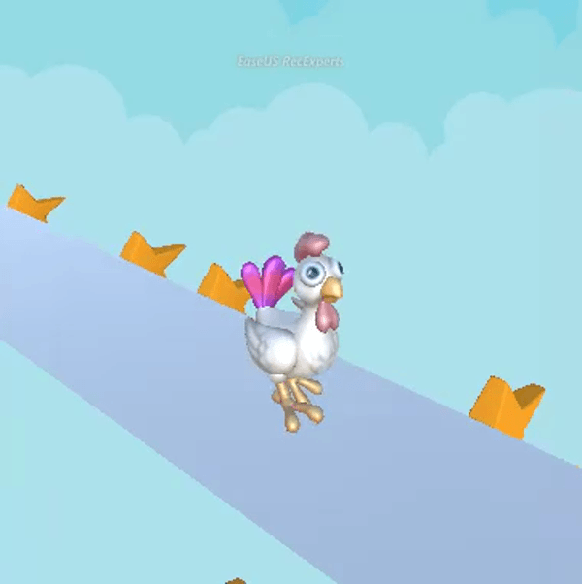
Characters(2)
Identity
Name: Mother Clucker
Age: 24 weeks
Purpose of life: Steal all the apples of the llama community!

Slide 9
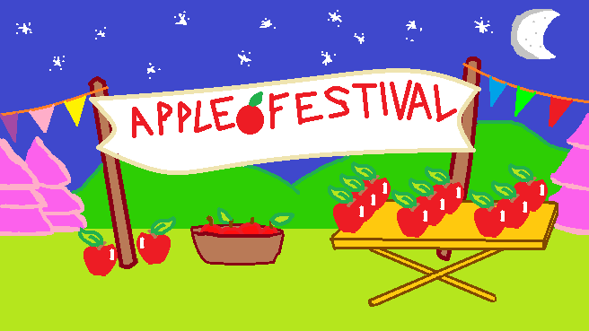
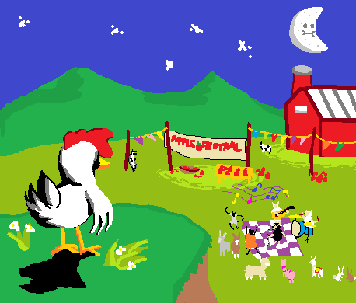
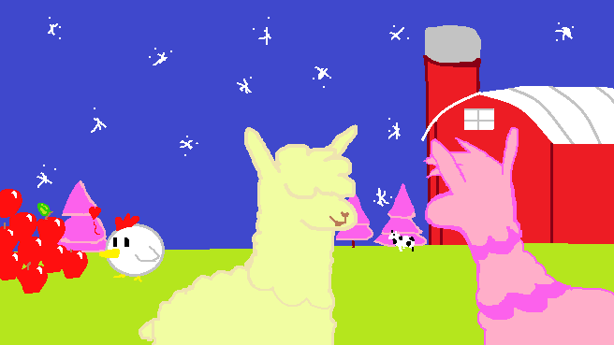
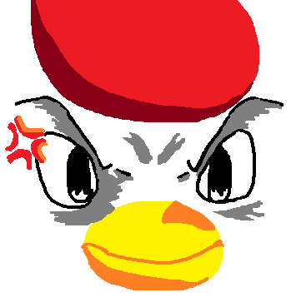
Story
Once upon a time, in the world of Animalia, everything flowed beautifully.
The night of the llama community’s annual apple festival was finally here.
At the same time...
...Mother Clucker was awaiting.

Slide 10
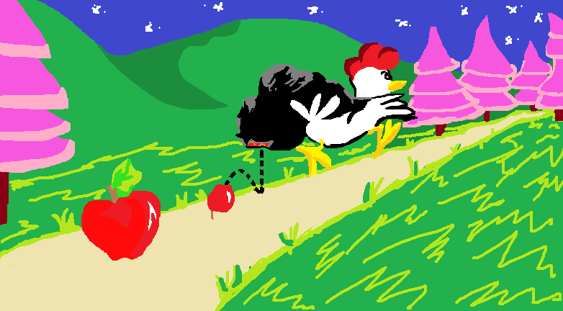
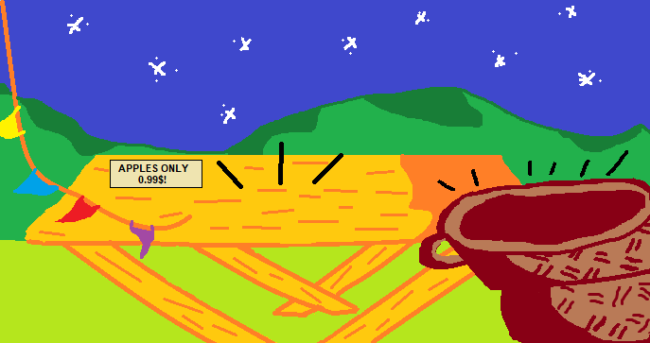
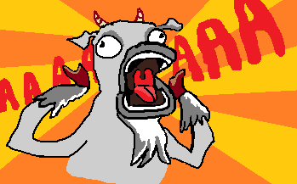
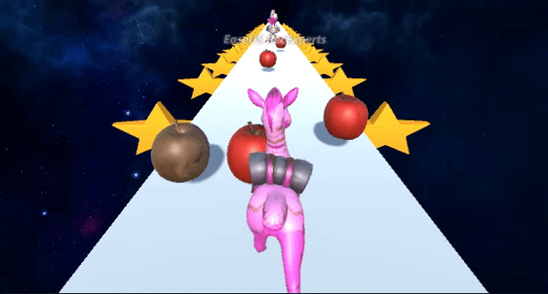
Story
Out of the blue, all the apples had
disappeared!
Young little Llama Del Ray went after Mother Clucker to find all the stolen apples.
Everyone was shocked!

Slide 11
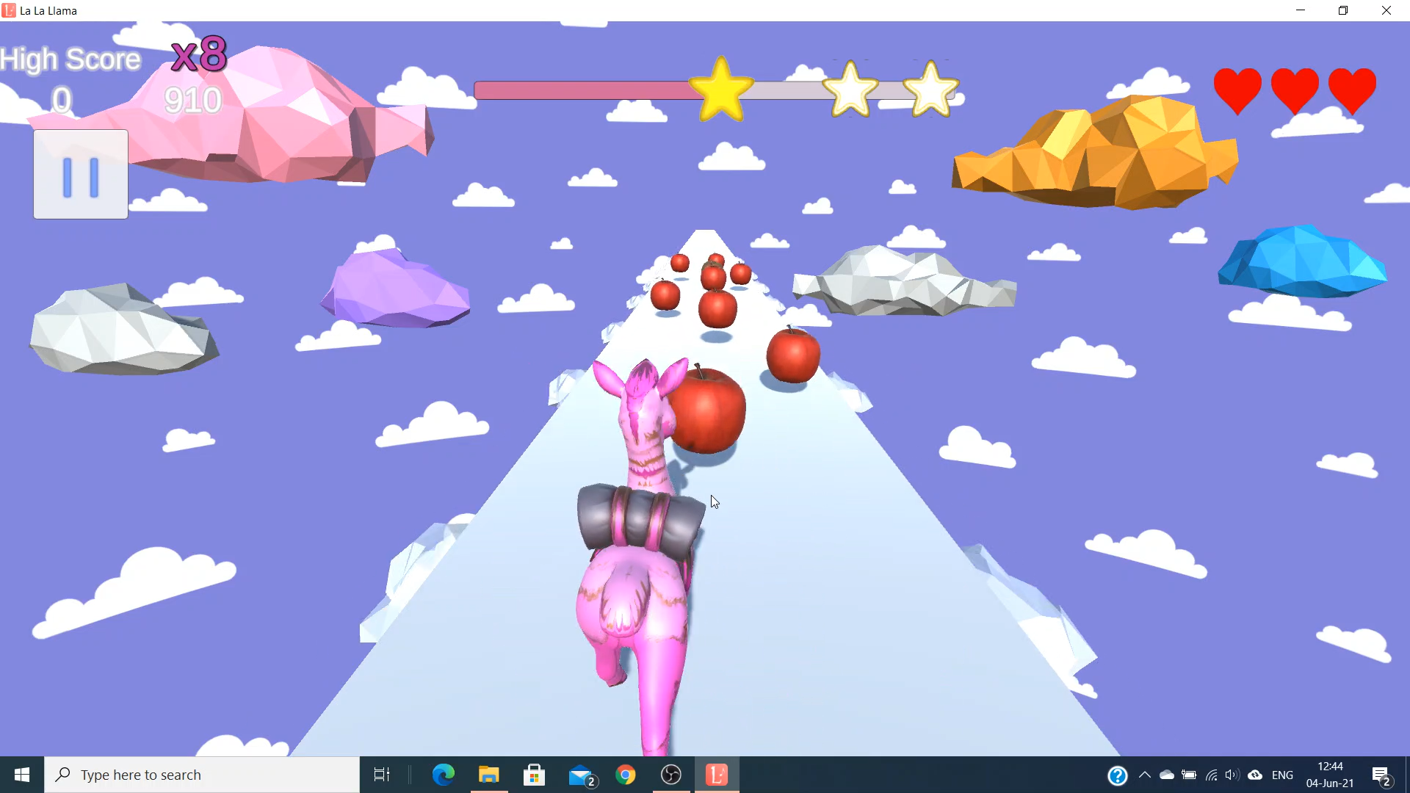
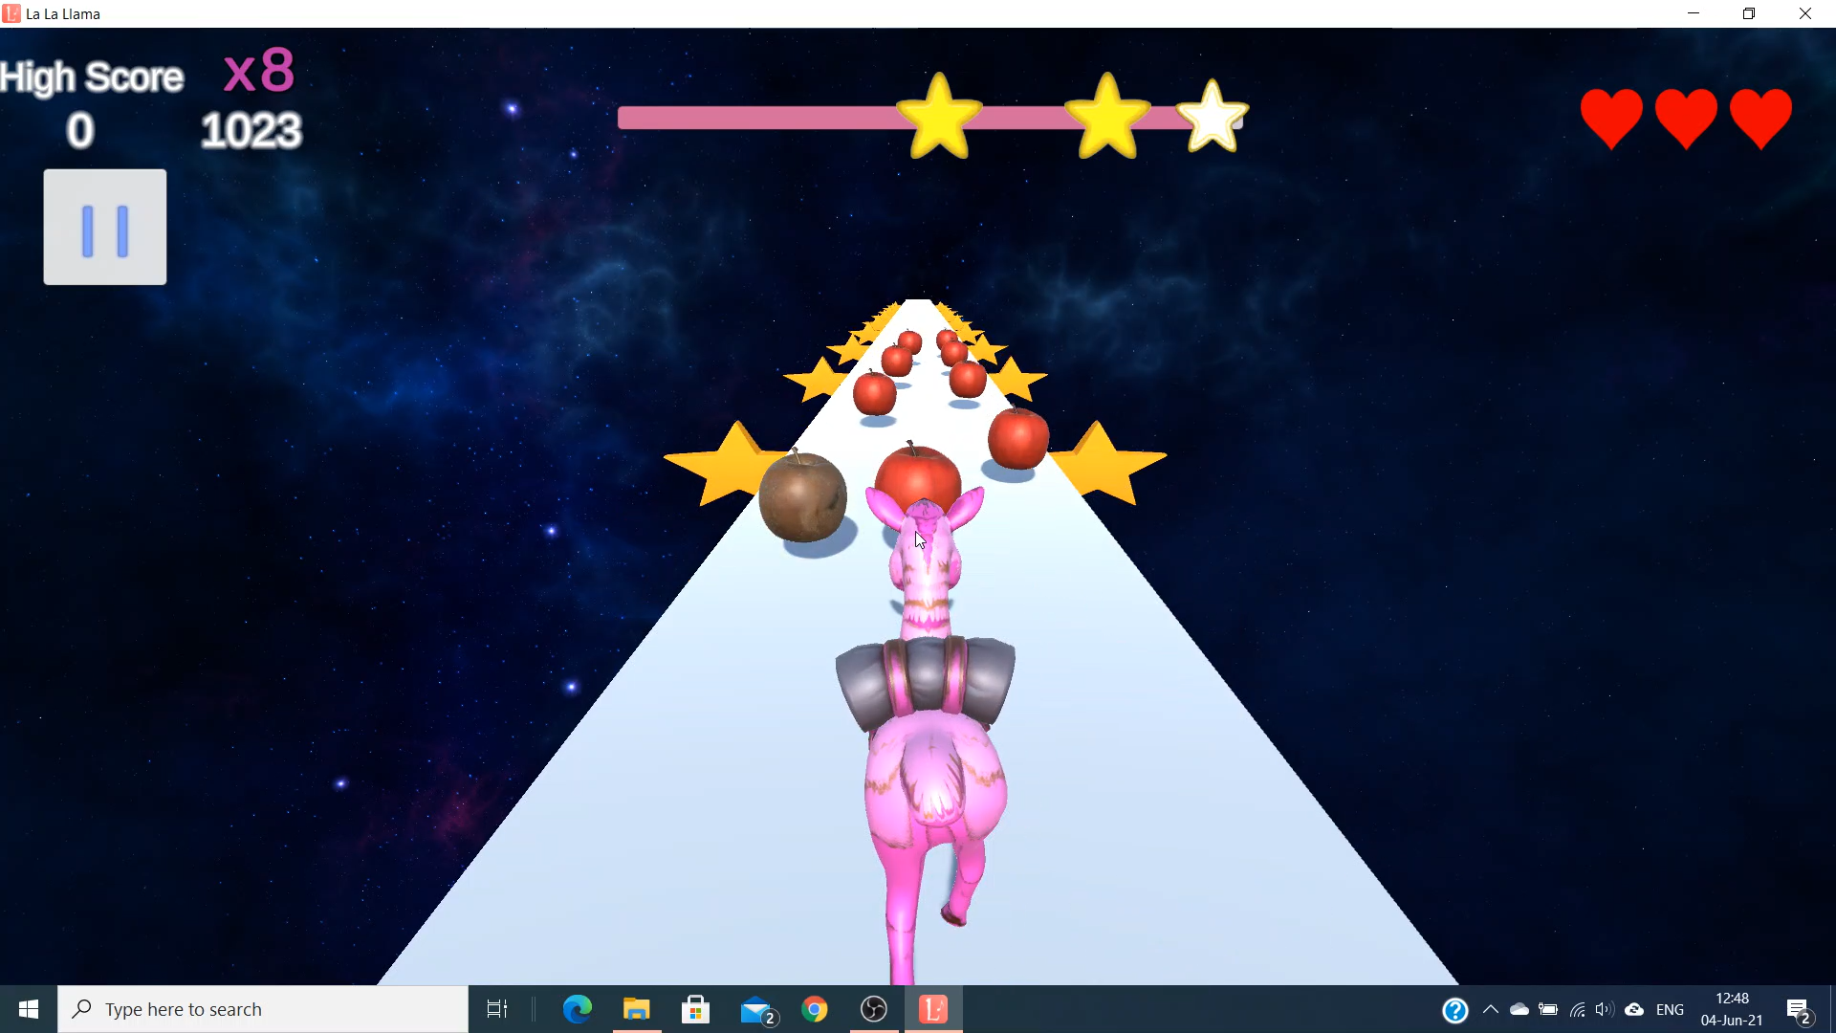
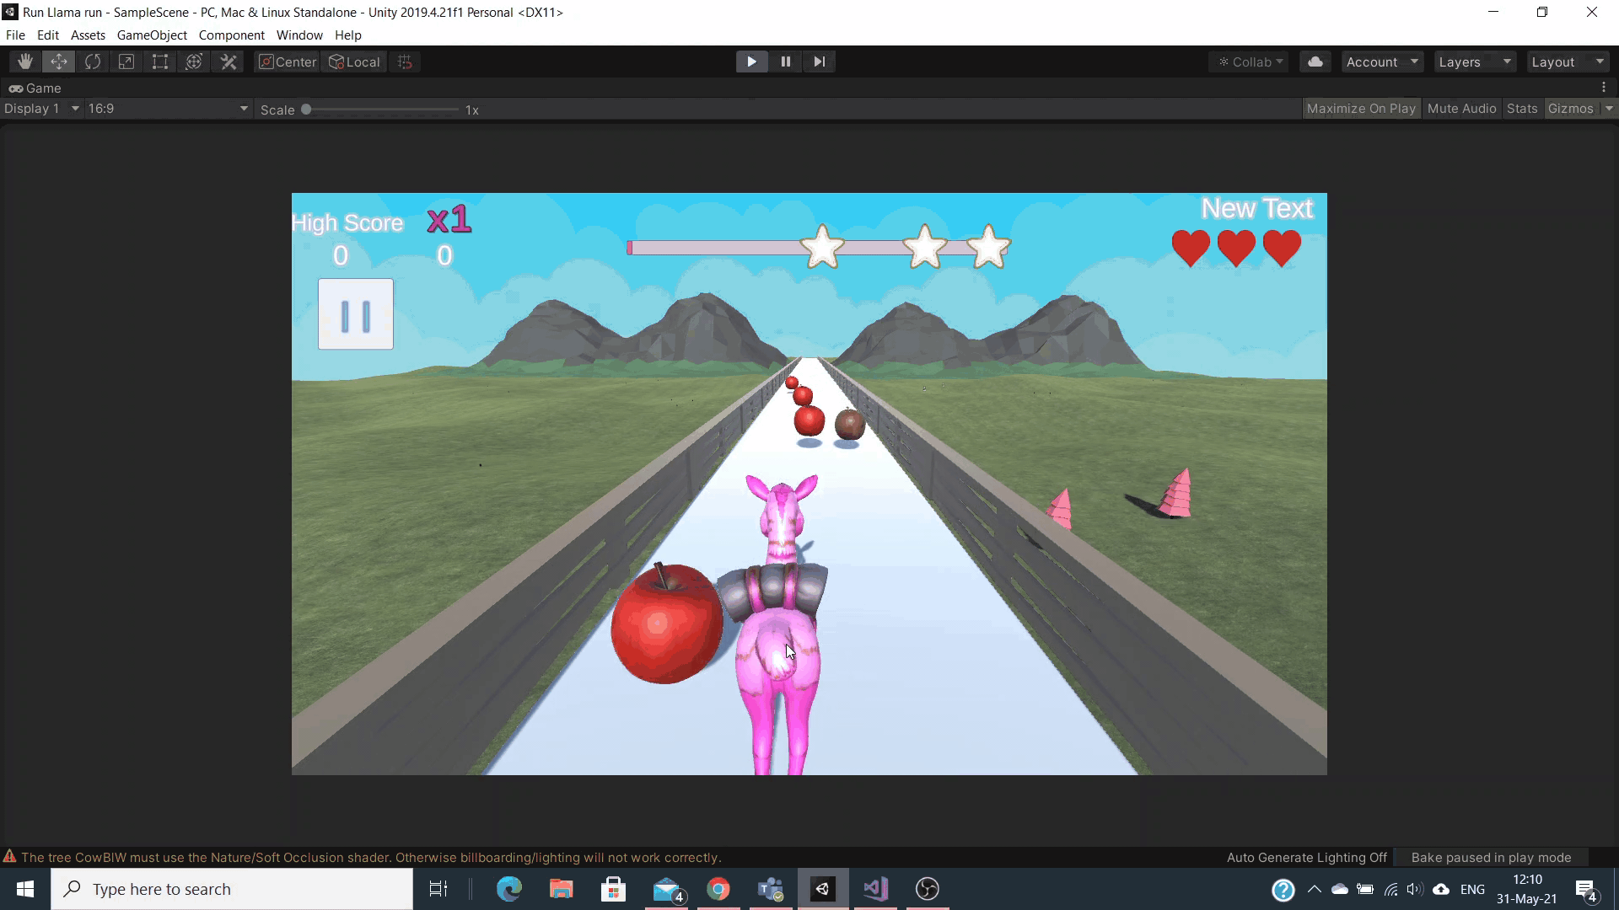
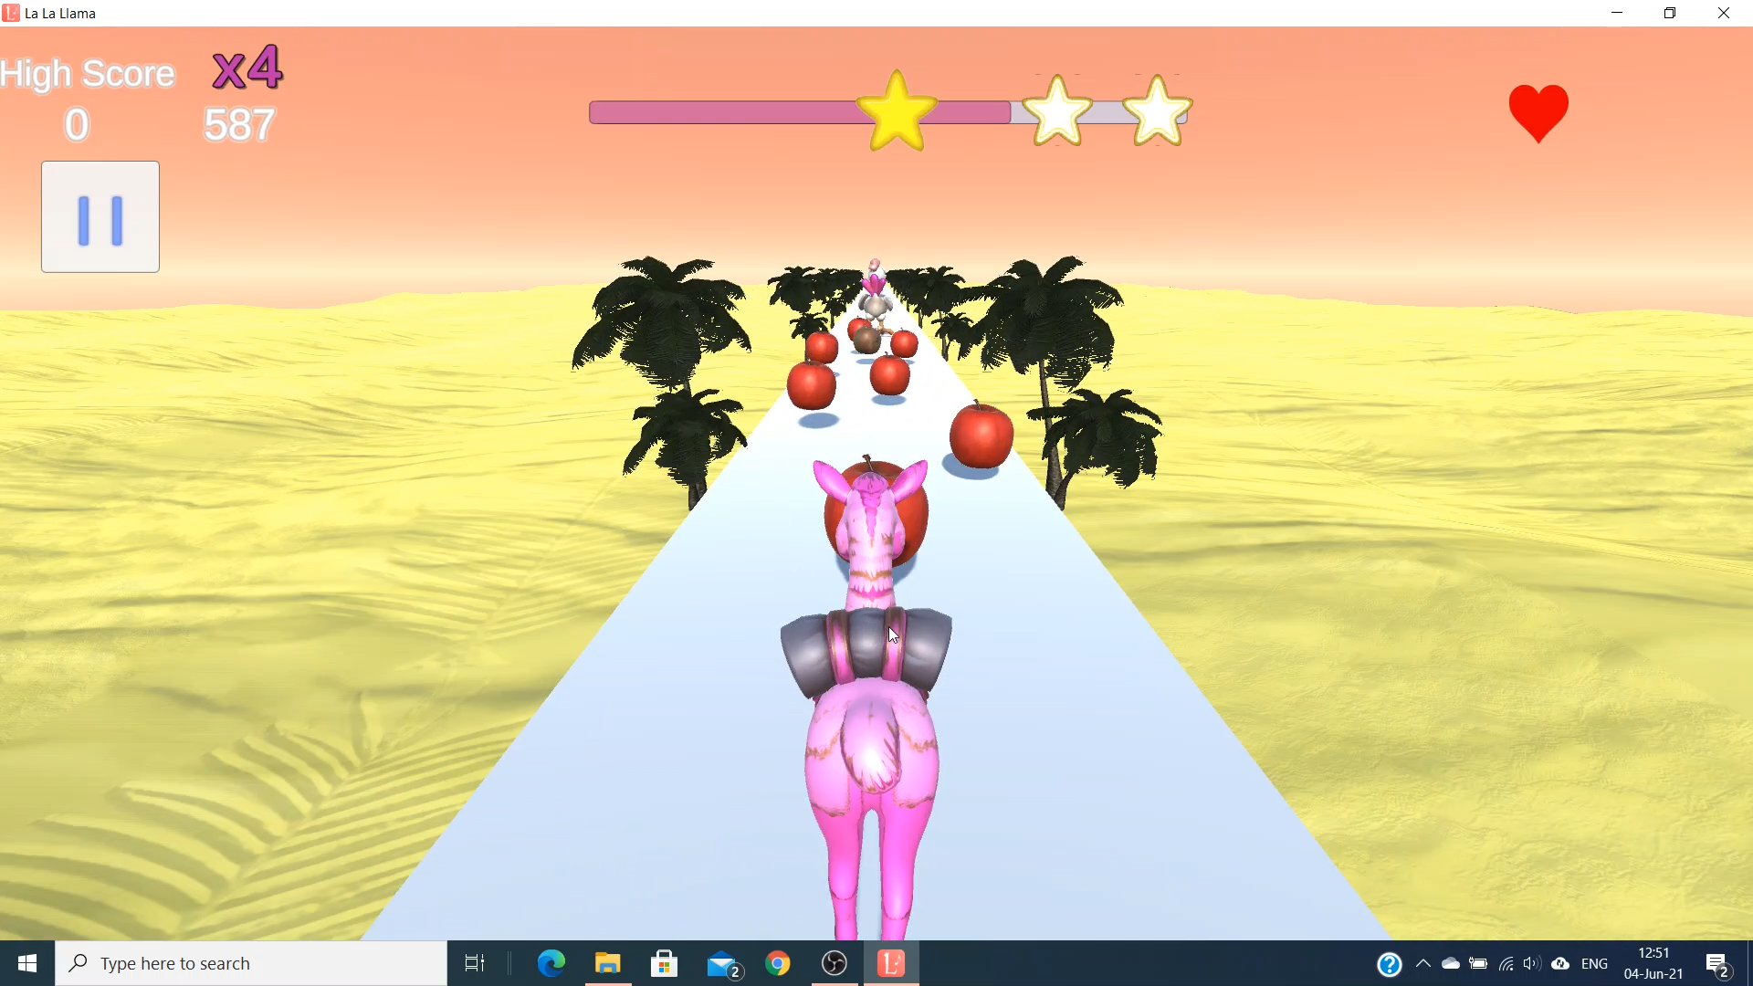
Levels
4 levels in demo
one music track per level

Slide 12
Implementation
When should apples been spawned?
At random times? ..NO!
First thought...
place apples in the scene one by one
extremely hard to synchronize with music
Find the times automatically!
Python library finds the times of a song’s notes
too good to be true :(
Back to manual ways...
is there a manual but easy and fast way to place apples?

Slide 13
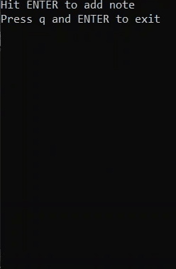
Implementation (2)
Use of a C program
listen to the music track
hit ENTER when it feels right
import times that ENTER was hit in Unity!
{ 0.000f, 0.579f, 0.928f, 1.050f, 1.318f, 1.436f, 1.784f, 2.160f, 2.934f, 3.496f, 3.904f, 4.023f, 4.284f, 4.399f, 4.755f, 5.145f }

Slide 14
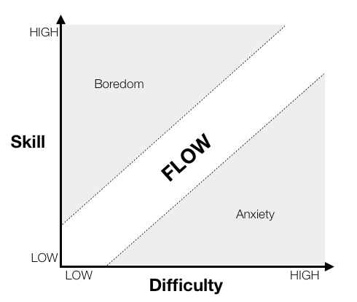
Implementation (3)
What about the position of the apples?
Also, what about the rotten apples?
Both of these questions affect the game difficulty.
x

Slide 15
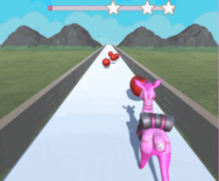
Implementation (4)
Increasing difficulty inside a level!
About the position of the apples
pick |Δx| at random from [L,U]
L and U are increased over time within a level
U is also affected by Δt between 2 consecutive apples
About the rotten apples
rotten apples appear next to apples
the probability for one to appear rises over time
over time, they appear more likely in the center
they are harder to avoid than these on the edges
Δx
x

Slide 16
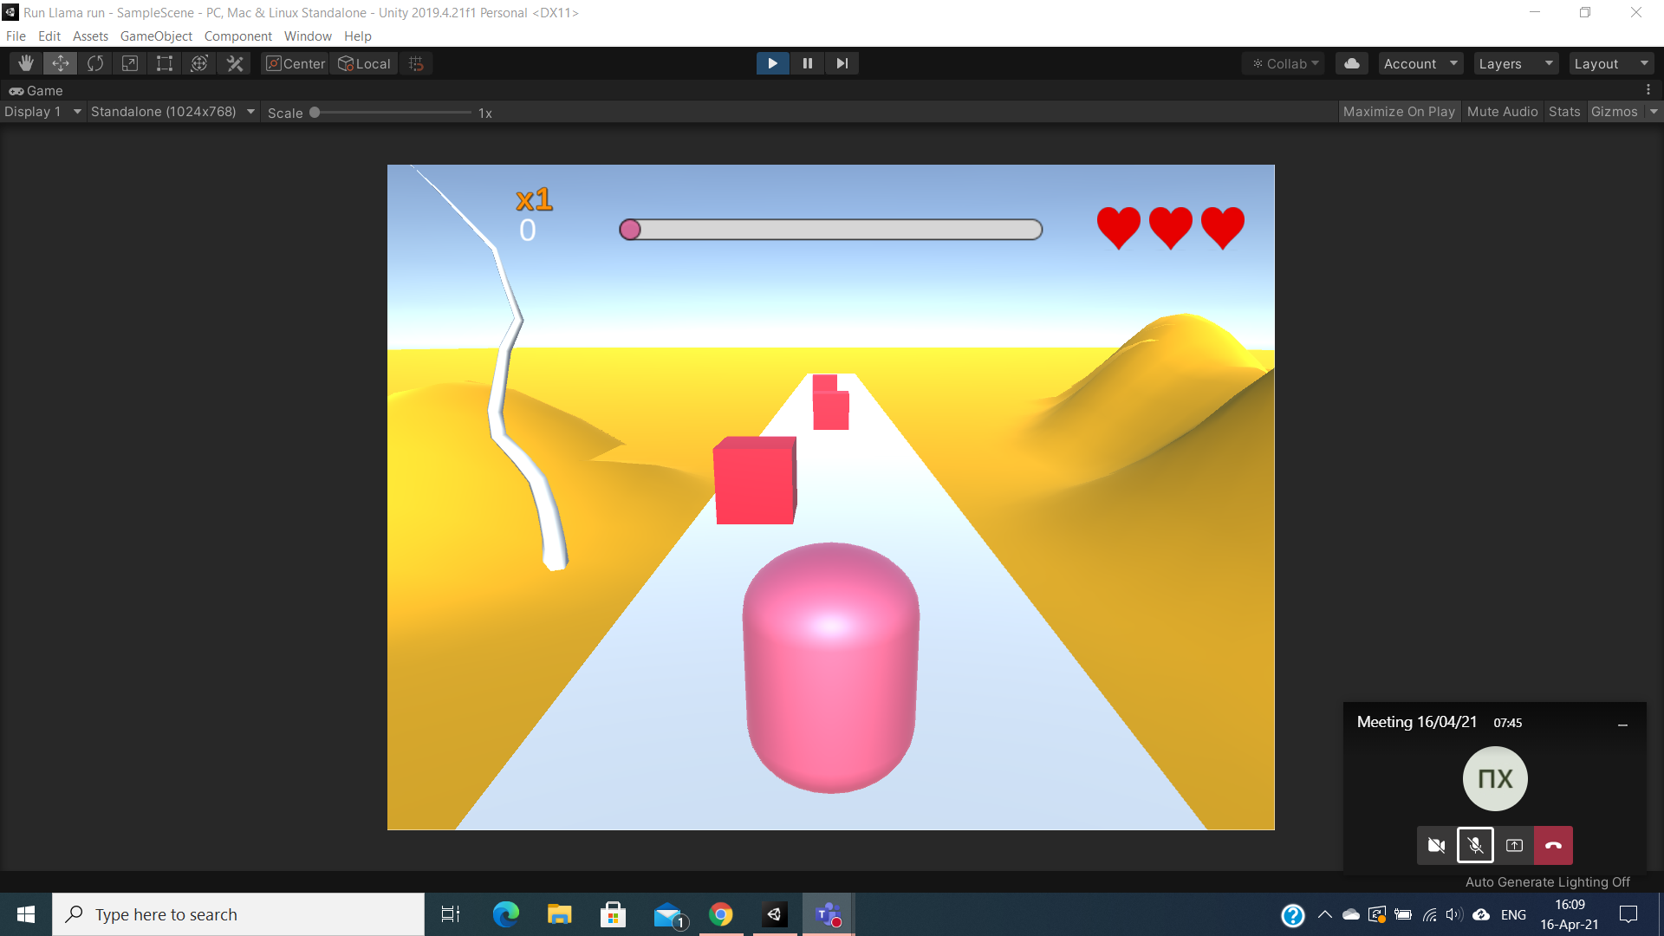
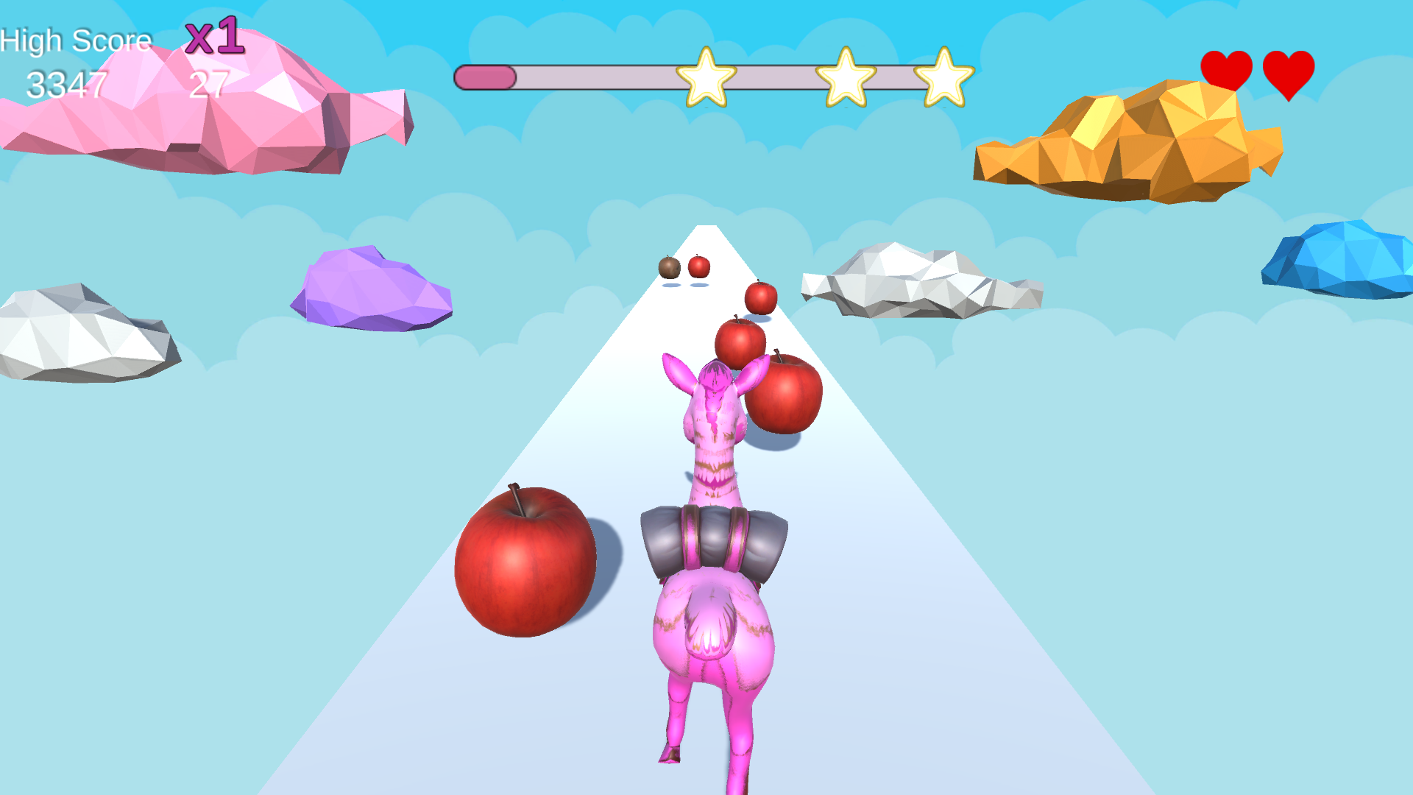
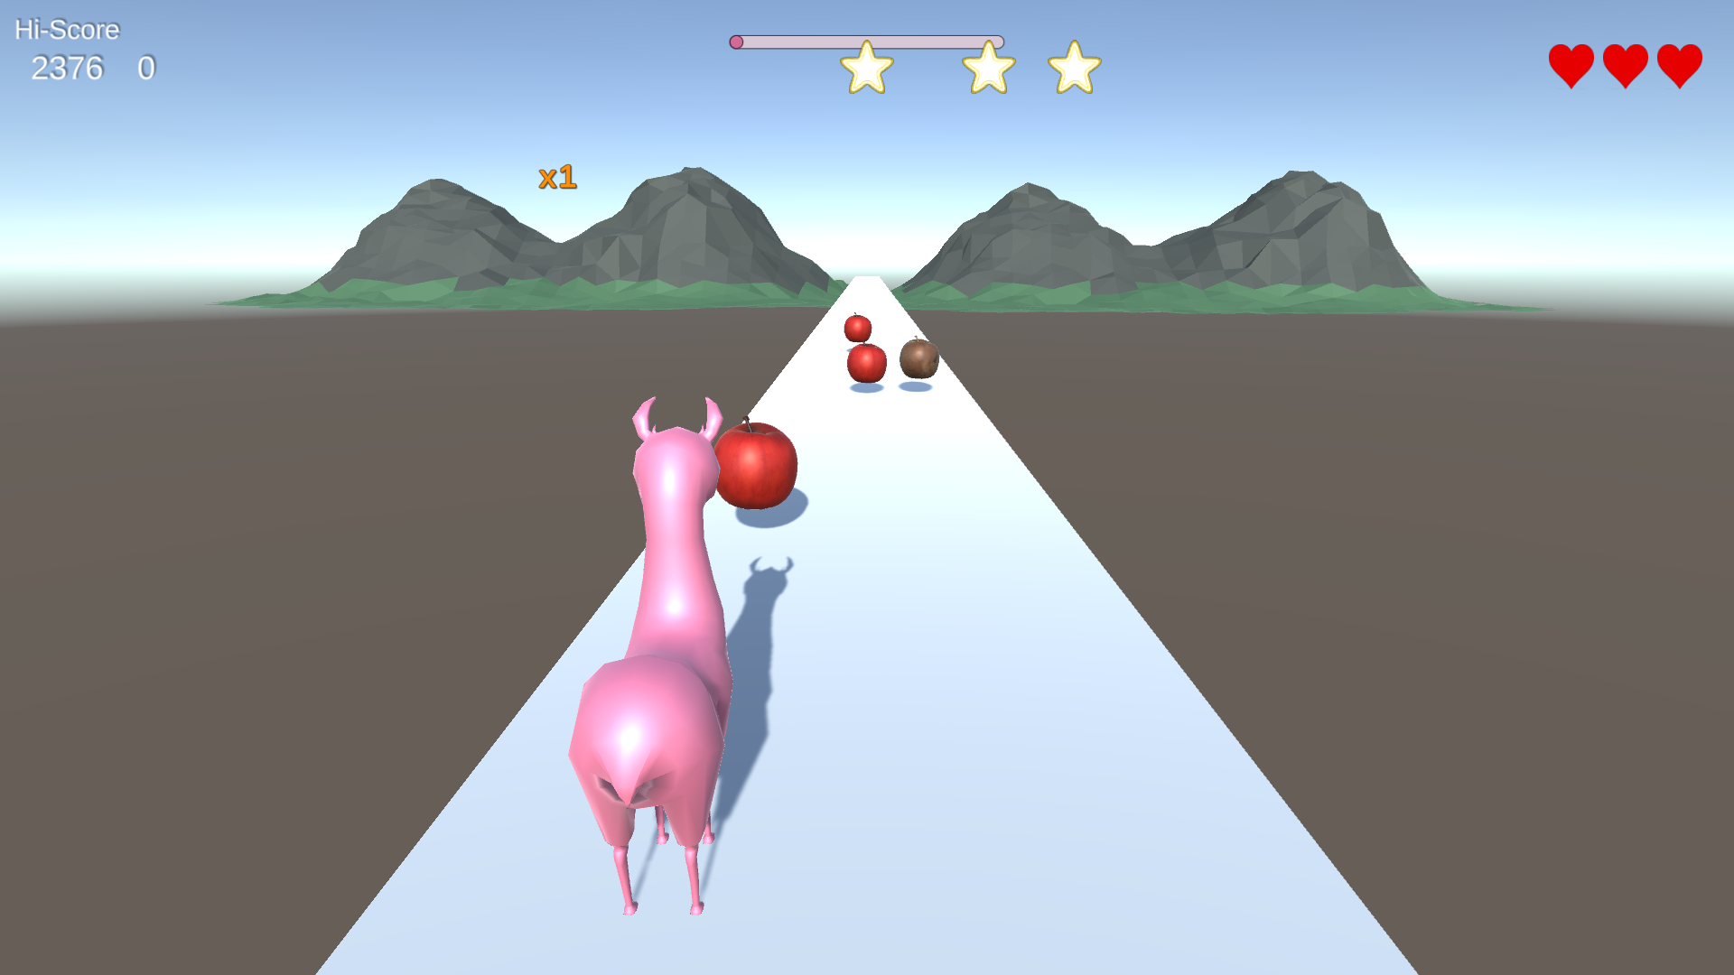
Progress
Today’s DEMO !!!

Slide 17
O
Team
‘
’
Thank you
Any questions?

